Slide 1

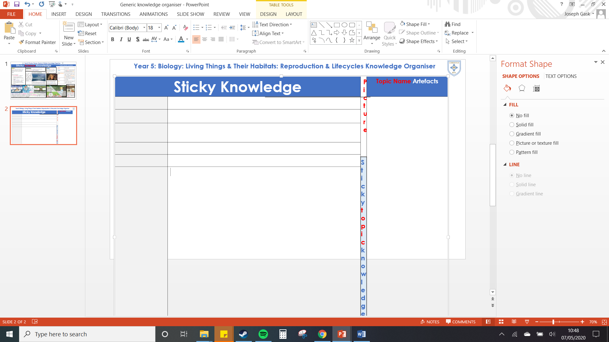
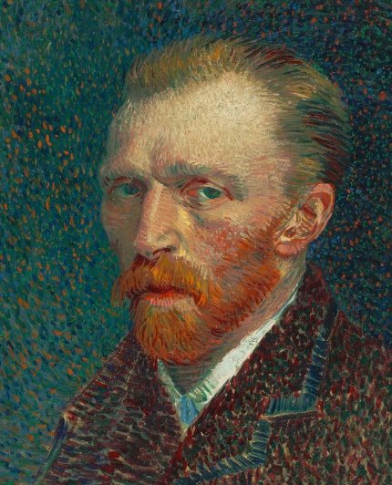
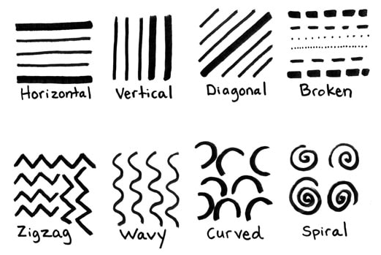
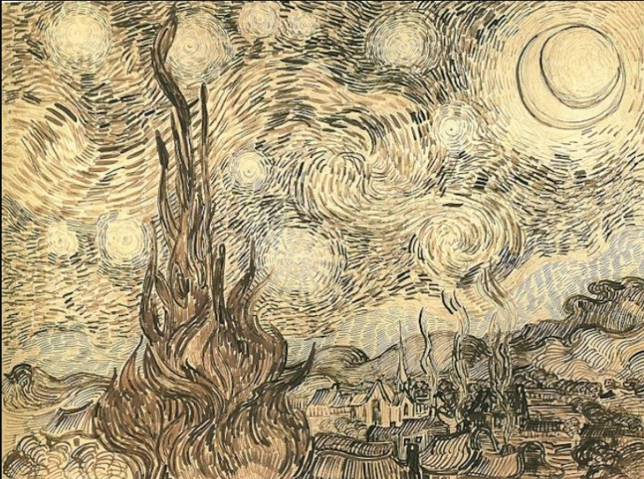
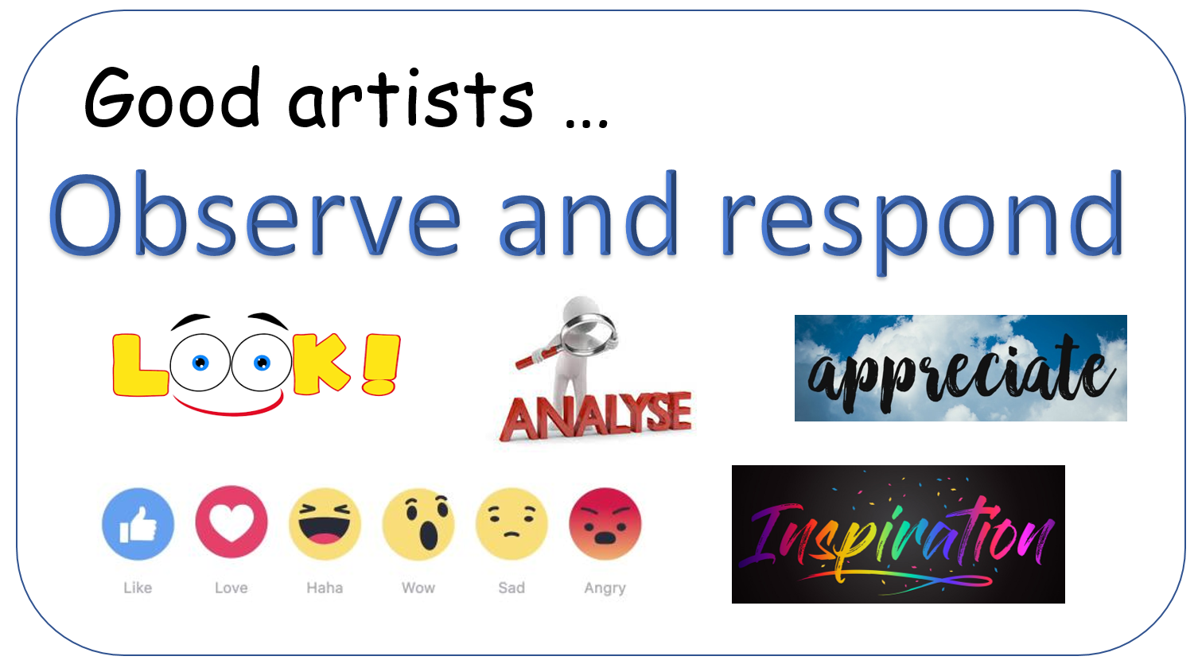
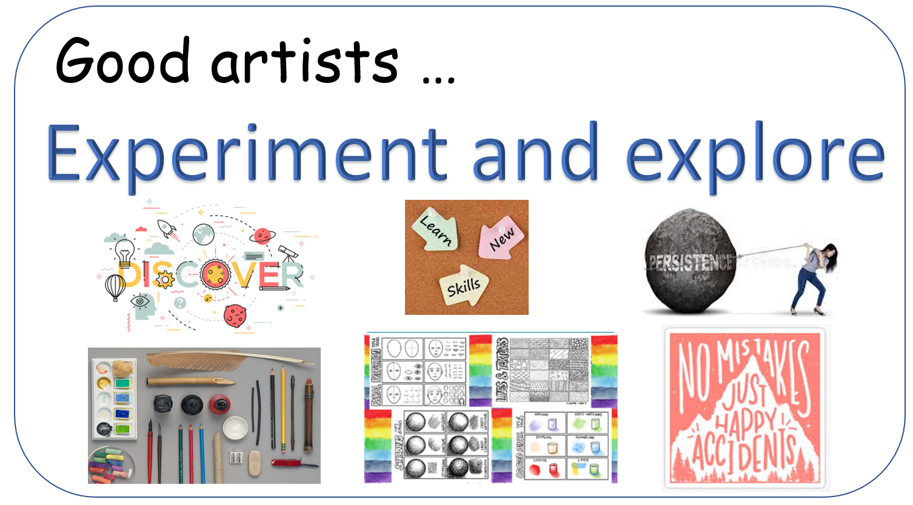
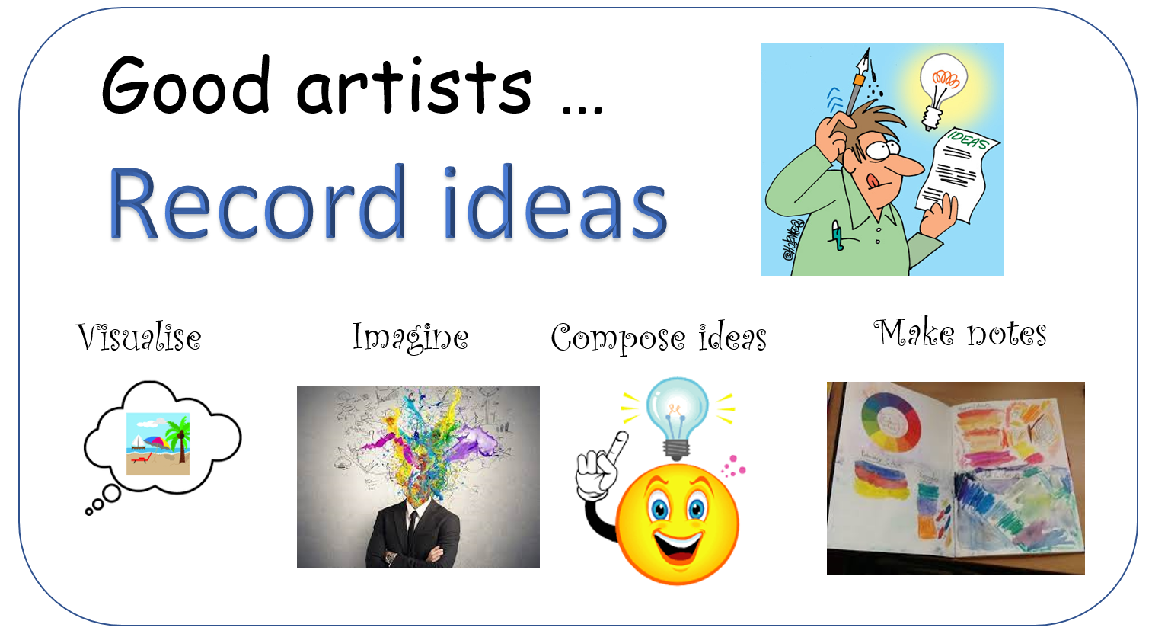
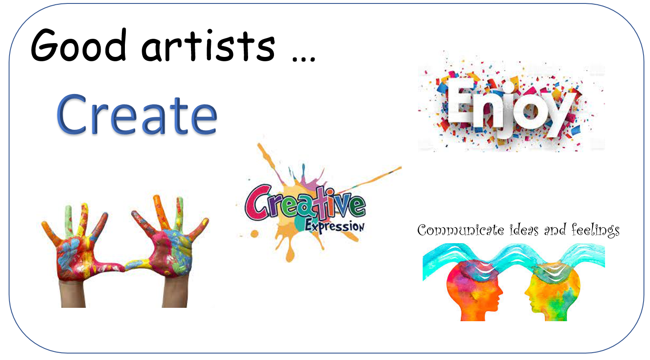
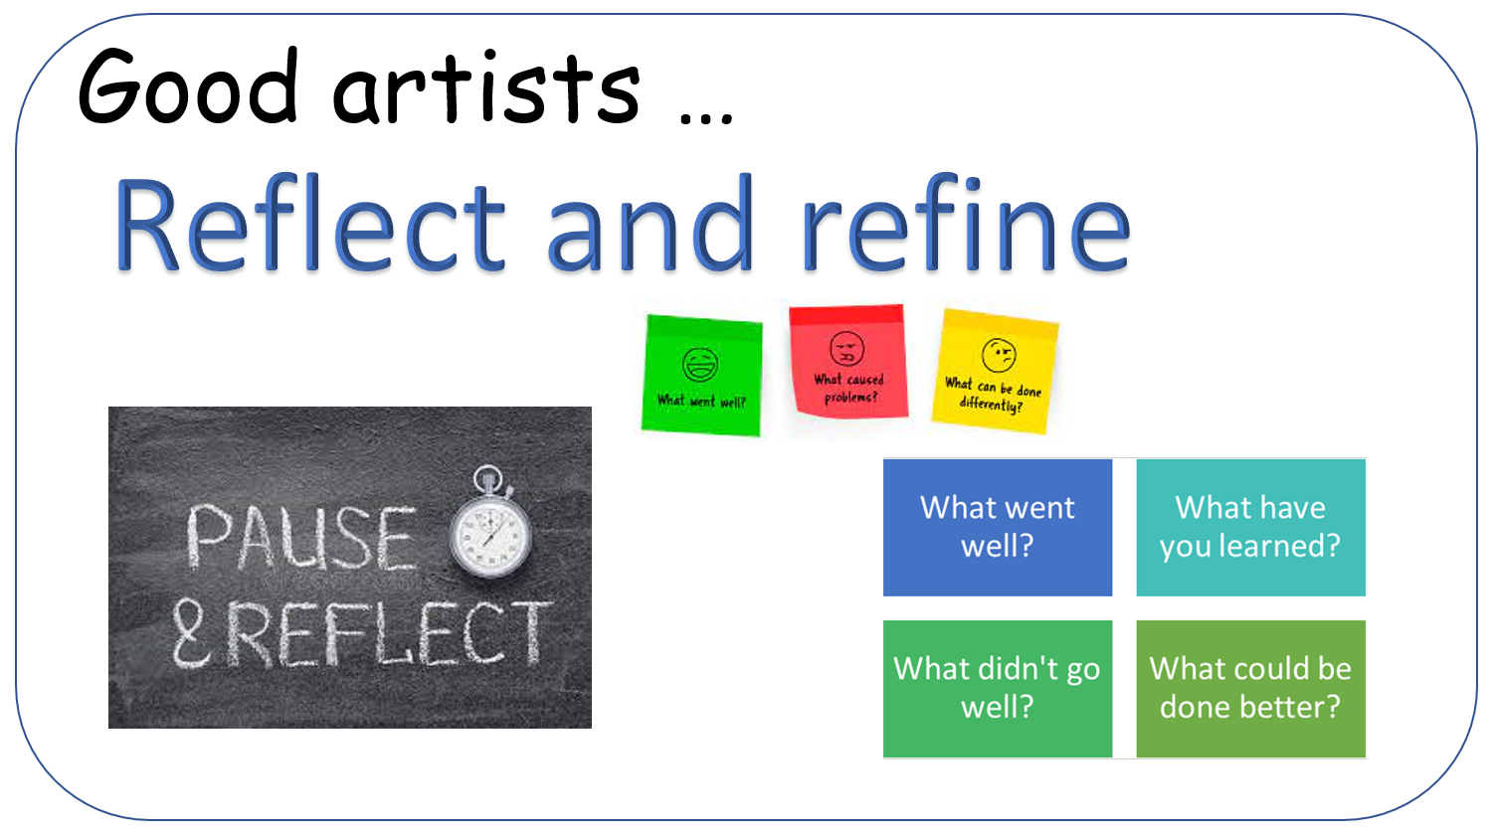
Art (drawing): Vincent Van Gogh
Key Vocabulary
line “A line is a dot that went for a walk” Paul Klee | There are 8 main types of lines in art: horizontal, vertical, diagonal, broken, zigzag, wavy, curved and spiral.
landscape | The features of an area of land.
texture | Texture is how the surface of something feels (tactile) or looks like it feels (visual texture).
pattern | A pattern is a repeated design.
Zentangle | A piece of art that includes patterns made by lines.
Key Knowledge
There are 8 main types of line in art.
Lines can create pattern and texture.
That pattern and texture can show tone.
That varying the texture can differentiate between one area of a picture and another.
Vincent Van Gogh 1853-1890)
He was born in Netherlands.
He only sold one painting in his lifetime!
After his death, he became one of the most famous artists.
He has drawn and painted over 900 different paintings such as Starry Night which is a landscape.
Skills: I can…
… vary my mark making.
… use mark making to convey feelings and emotions.
… justify and explain my artistic choices.
The Starry night. Ink and Paper, June 1889

