Slide 1

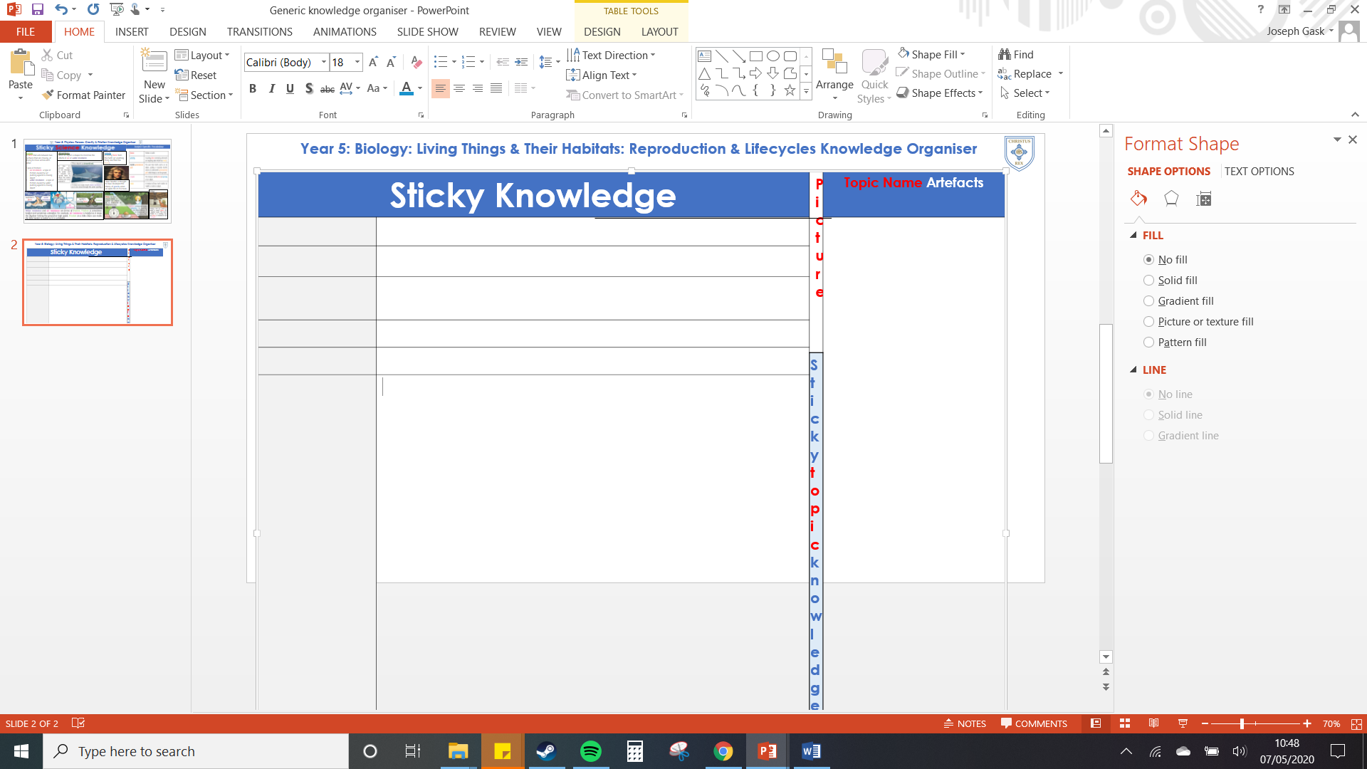
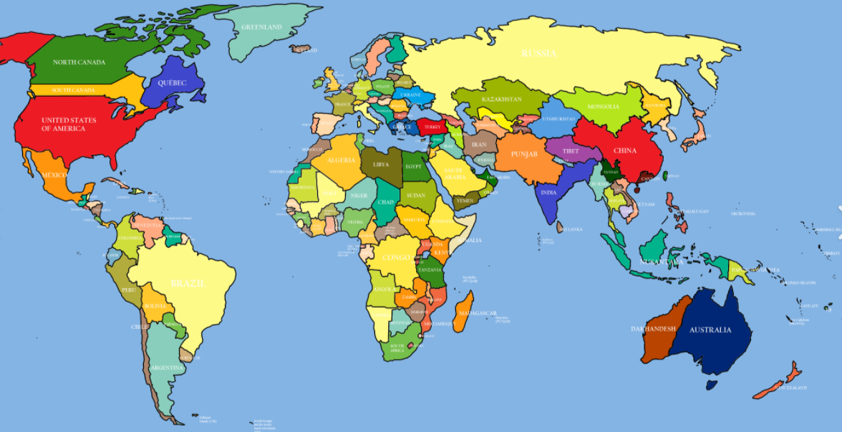
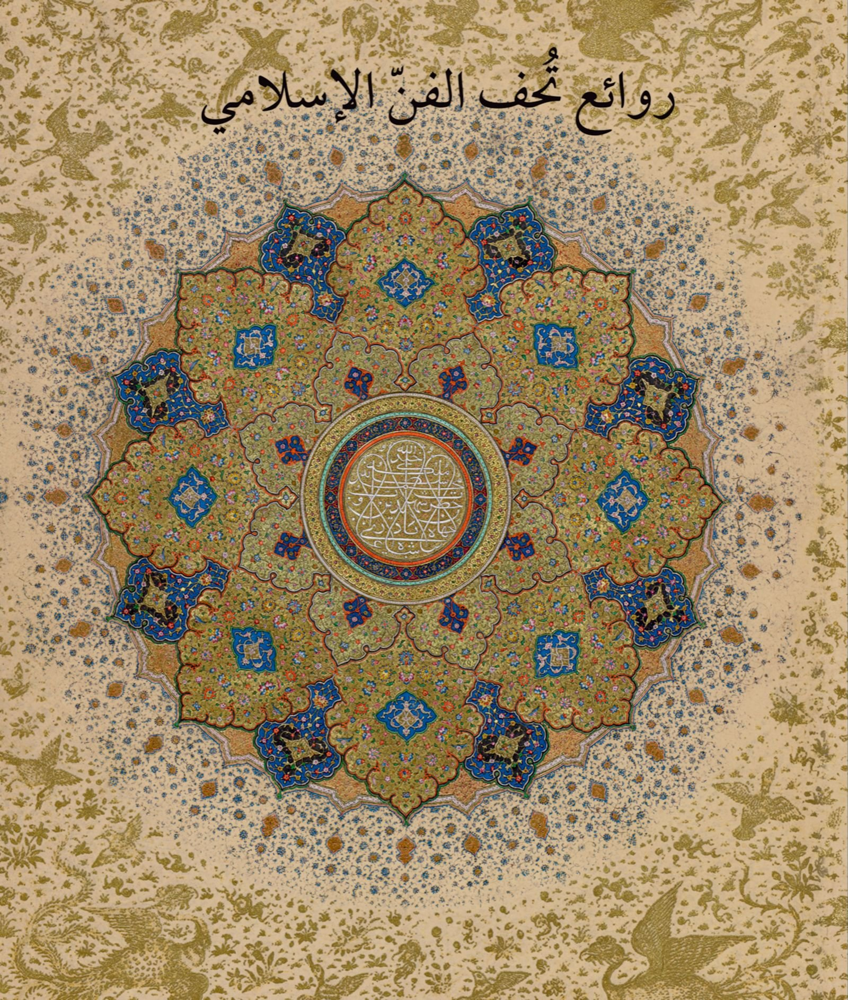
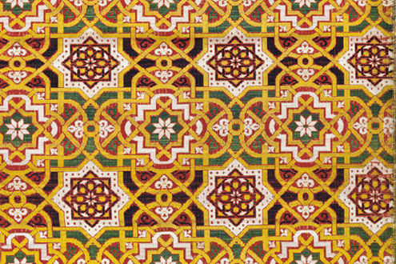
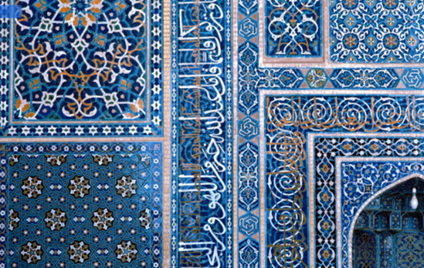
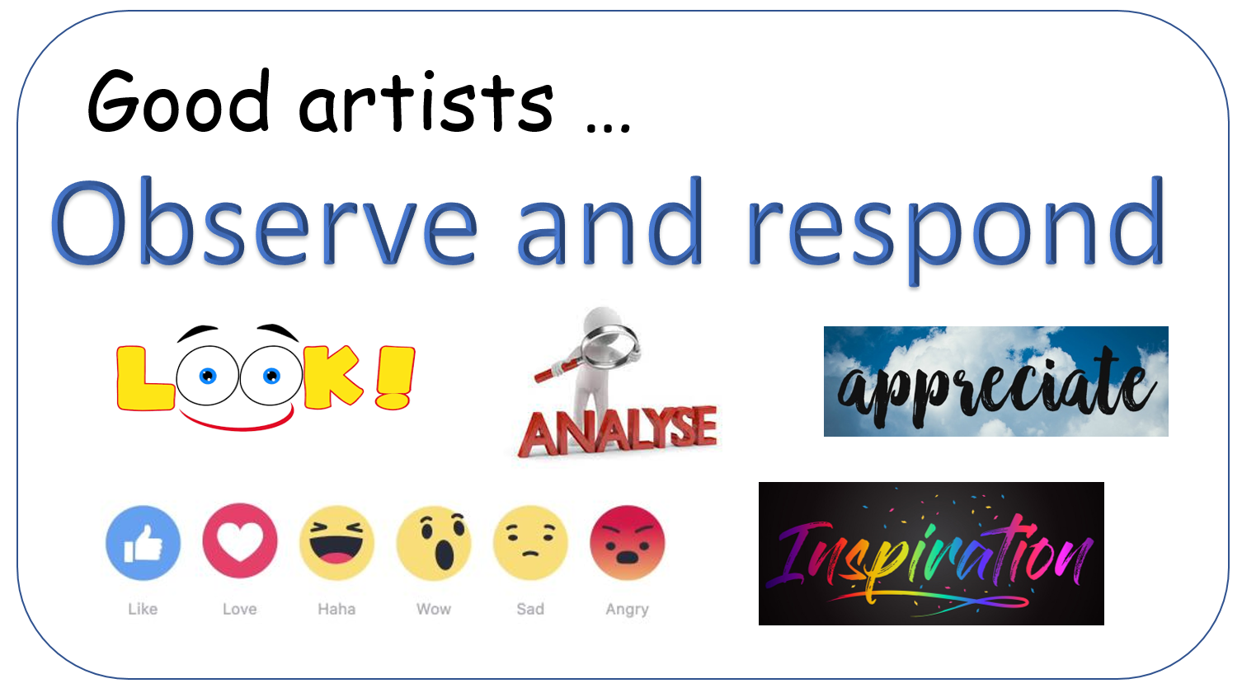
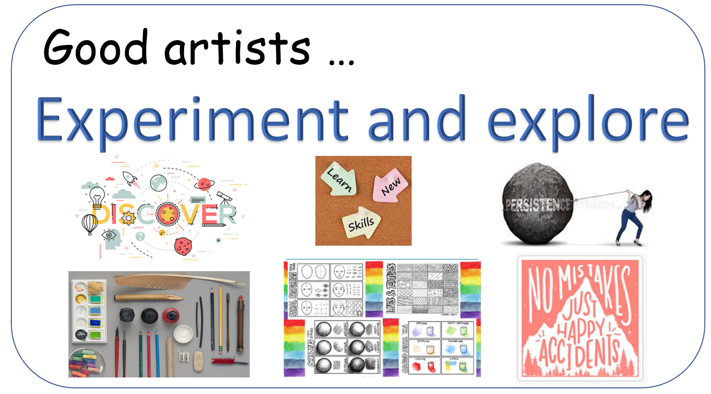
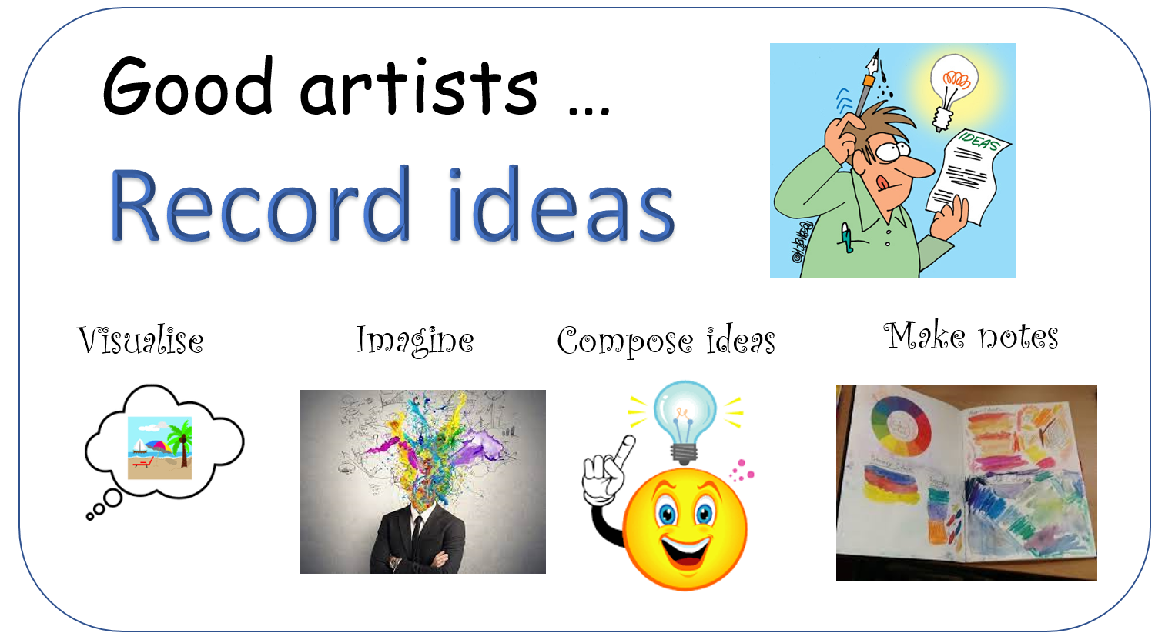
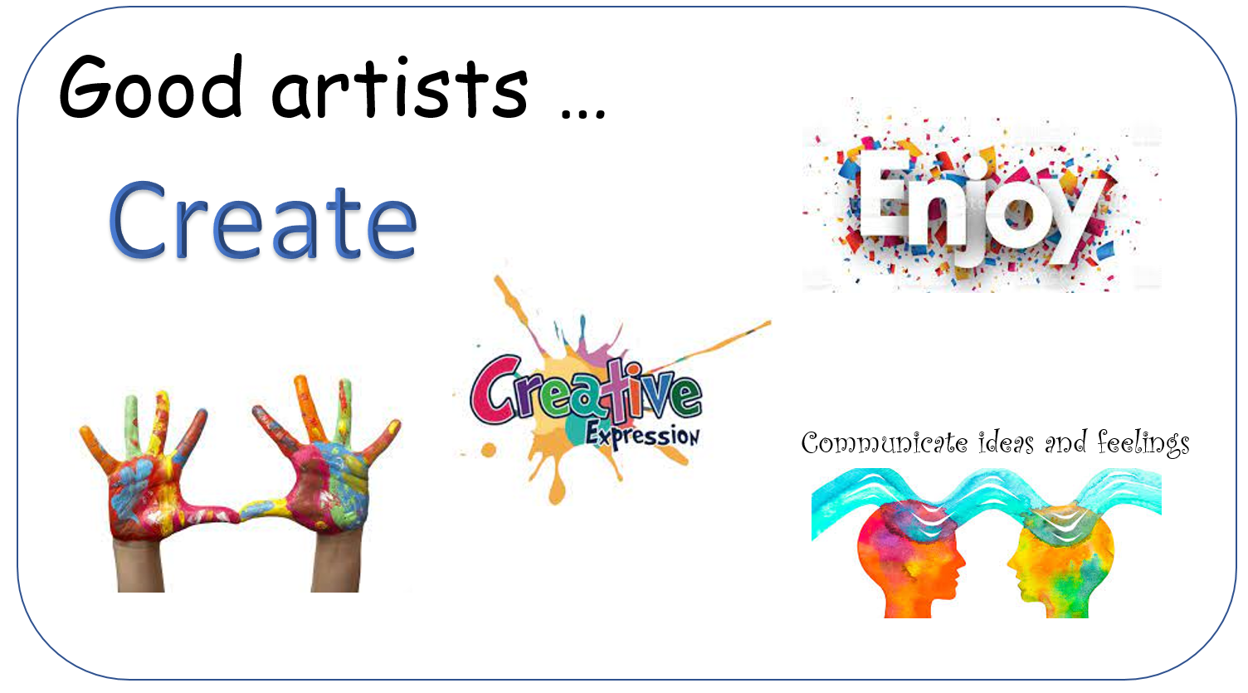
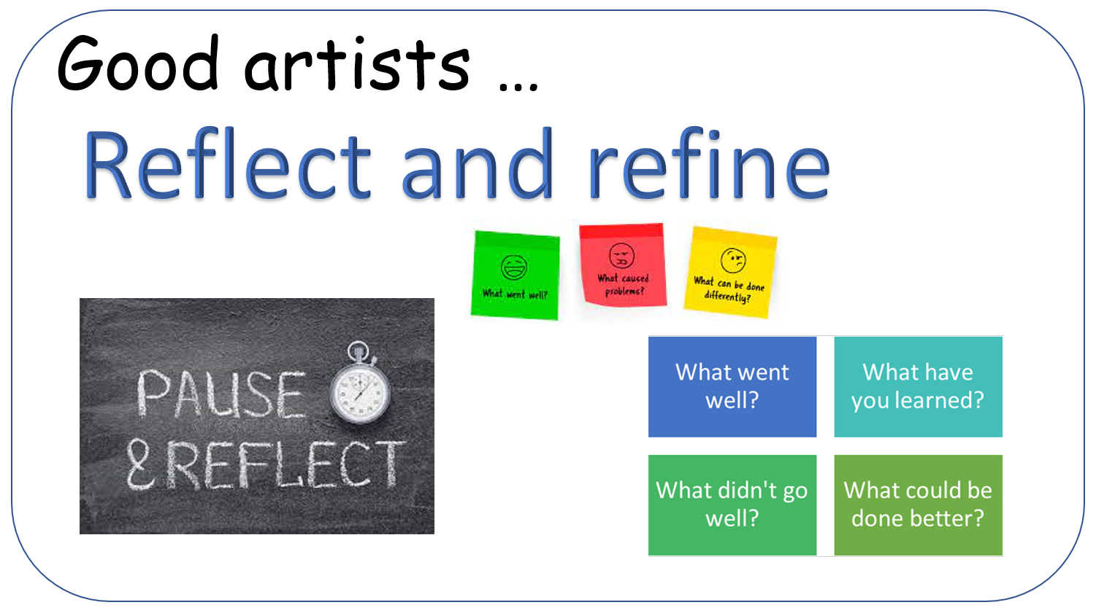
Art (painting): Islamic Decorative Art
Key Vocabulary
Lino printing | A printmaking technique which is an effective method for creating multiple prints of an artistic piece.
Etching | A technique which involves making indents or incisions into a surface.
Rotate | To turn around a central point.
Pattern | A design that repeats.
Key Knowledge
Islamic art does not often feature depictions of figures or living things and focuses on patterns.
Islamic art can often be found in the Middle East.
Images can be transferred onto tracing paper.
Lino is a material that can be etched onto in to transfer a design from tracing paper.
A print is transferred in reverse.
Collaborative artwork is when artists work together towards a final piece.
Skills: I can…
…design a pattern.
… trace and transfer my designs.
… etch lino.
…print my own decorative art.

