Slide 1
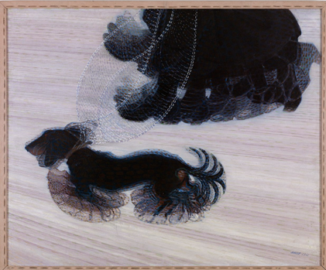
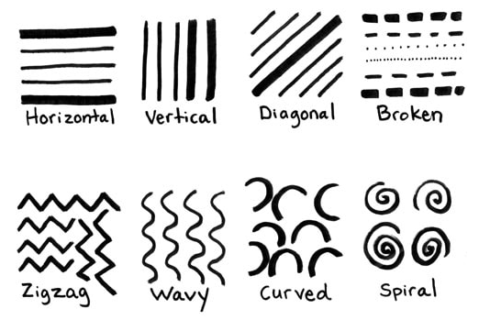
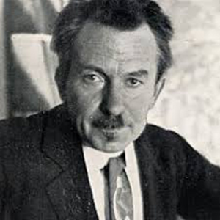
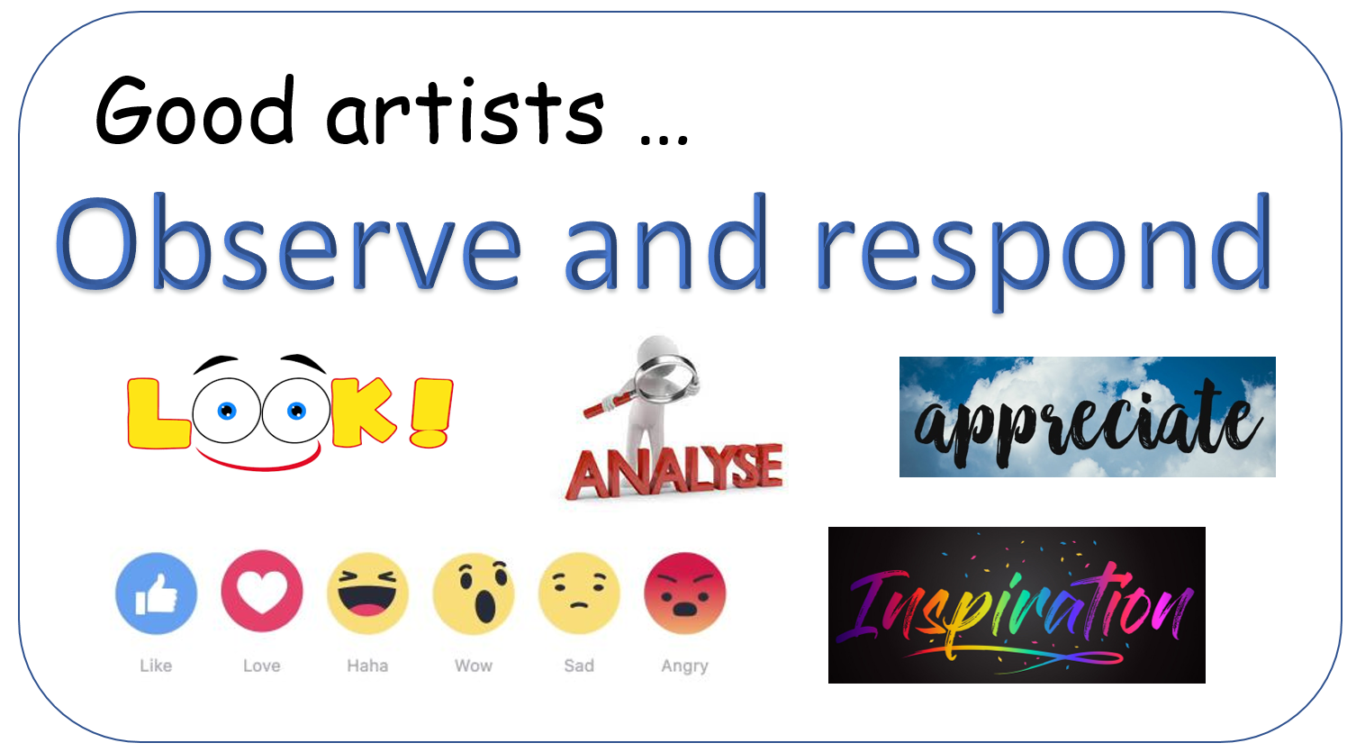
Art (drawing): Dynamism of a Dog on a Lead by Giacomo Balla
Key Vocabulary
line “A line is a dot that went for a walk” Paul Klee | There are 8 main types of lines in art: horizontal, vertical, diagonal, broken, zigzag, wavy, curved and spiral.
shape | An enclosed space, a bounded two-dimensional form that has both length and width.
form | Something that is three-dimensional and encloses volume.
perspective | The representation of three-dimensional objects or spaces in two-dimensional artworks.
Key Knowledge
Art can show different proportions of the human body.
Movement can be depicted by layered sketches.
A variety of media can be used to create line and tonal drawing.
Skills: I can…
…make a choice of media.
… create quick life drawing.
… create sketches.
…justify and explain my artistic choices.
Giacomo Balla (1871-1858)
He was born in Italy
Best known as a key proponent of futurism.
He was concerned with expressing movement in his works.
He has drawn and painted around 70 different paintings!

