Slide 1
Notes:
We will have a go!

Slide 2
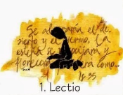
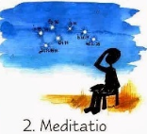
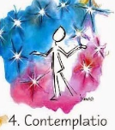
Read
Reflect
Respond
Rest

Slide 3
A reading from the Gospel according to Luke
Lord be on my mind, Lord be on my lips, Lord be in my heart
Jesus went into Jericho and was passing through. There was a chief tax collector there named Zacchaeus, who was rich. He was trying to see who Jesus was, but he was a little man and could not see Jesus because of the crowd. So he ran ahead of the crowd and climbed a sycamore tree to see Jesus, who was going to pass along that way. When Jesus came to that place, he looked up and said to Zacchaeus, ‘Hurry down, Zacchaeus, I want to visit your house today.”
Zacchaeus hurried down and welcomed him with great joy. All the people who saw it started grumbling, “This man has gone as a guest to the house of a sinner!”
Zacchaeus stood up and said, “Listen, sir! I will give half my belongings to the poor, and if I have cheated anyone, I will pay back four times as much.”
Jesus said to him, “Salvation has come to this house today, for this man, also, is a descendant of Abraham. The Son of Man came to seek and to save the lost.”
(19: 1 – 10)

Slide 4
Notes:
We will have a go!

Slide 5
`
Thank you God for allowing us to hear your Word and to become closer to you; may we take it and use it in our lives.

