Slide 1
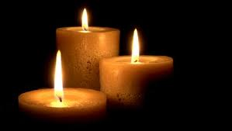

Slide 2
Get ready to meditate importance for stillness & silence
Sit upright & be still
Open hands on your lap
Slightly close your eyes
Go to your heart room
Slowly repeat your prayer word or mantra
In 4 equal syllables
MAR-RA-NA-THA

Slide 3
Meditation Begins
The gong sounds 3 times
1-5 mins stillness & silence
Repeat your prayer word throughout the meditation
MA-RA-NA-THA
After 1-5 mins the gong sounds 3 times

Slide 4
Opening Prayer
Jesus open our ears to hear your voice.
Open our eyes to see your face.
Open our mouths to speak your words.
Open our hearts to your love.
Open our hearts to your love.

Slide 5
Close your eyes and say your prayer word gently and lovingly:
Ma-ra-na-tha

Slide 6
The gong will sound, gently open your eyes and sing the Blessing song

Slide 7
Blessing at the End of the Meditation
We call you O God
And on Jesus Christ our Son
Through the power of the Spirit
That make are truly one.
We ask you to bless us
And lead us in your ways
As you guide us on our journey every day.

